Slide 1

Global Plastic Pollution

Slide 2
Our Team Member
Shivam Singh (RA2011003010087)
SREEKANT NAIR (RA2011003010096)
Nilesh Kumar Singh (RA2011003010380)

Slide 3

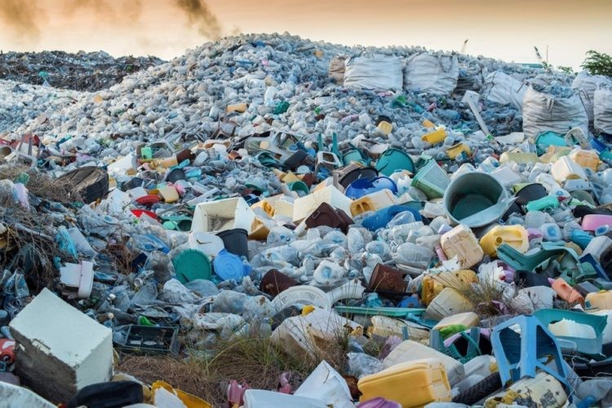
Introduction
12 million tonnes of plastic finds its way into the ocean every single year. 9.5 million tonnes of this enters the ocean from the land with 1.75 tonnes being chucked into the sea directly from the fishing a shipping industry. There are approximately 51 trillion microscopic pieces of plastic, weighing 269,000 tons.

Slide 4
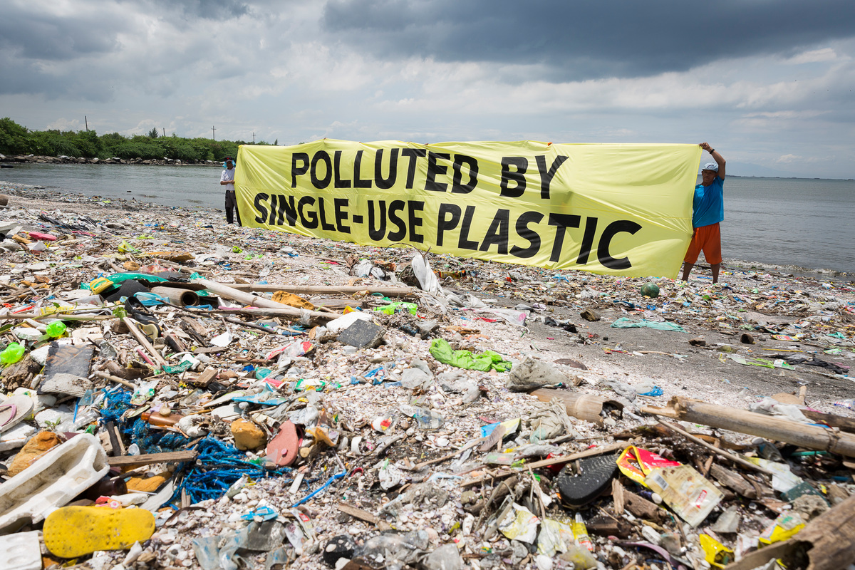
Information about source data
As we all know that the More and more plastic is being generated every year and more of which is getting dumped into the ocean or is mishandled.
The data has been obtained from kaggle.com which is to focus the study on Global Plastic Pollution to understand how much plastic a country produces over a year's period and how much of that plastic is mismanaged.
and also allows us to download the data for the same, for our visualization we use the data of this project.

Slide 5
Datasets contains:
Along with this, it contains waste generated per person (per day/kg) & mismanaged waste per person (per day/kg) for the year
Global plastic production from year
Global plastic production from year
2000
2012
1950
2010
2015
Contents Title

Slide 6
Data Description
IN this datset there are 26 columns
String -- country name ,country code,
Integer---- year, Total population,
Decimal---- per captail waste,gdp

Slide 7
Plastic pollution is having a negative impact on our oceans and wildlife health
High-income countries generate more plastic waste per person
In some regions, marine sources dominate: More than 80% in the Great Pacific Garbage Patch (GPGP) come from fishing nets, ropes and lines
To make aware people that what amount of he amount of plastic that we use?
Expected Output - Storytelling
ALLPPT.com

Slide 8
THANK YOU
Insert the Subtitle of Your Presentation

